Slide 1
Functions
Operation Spark Bootcamp

Slide 2
rect(10,14,100,25);
Notes:
So far we have been doing alot of drawing.
You’ve been doing alot of this.

Slide 3

rect(10,14,100,25);
SO WUT?
Notes:
And you may be wondering how that can ever lead to...

Slide 4
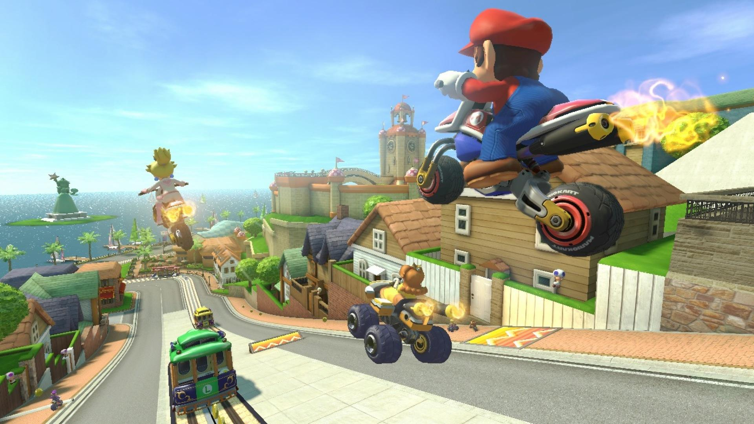
Notes:
THIS.
So how do we start to make stuff that a little more interesting

Slide 5
FUNCTIONS!
Notes:
Functions. Has anyone heard of these?
Functions allow us to take a bunch of instructions and group them together into a thing
(Mcdonalds example)
So lets walk through how you make a function and use it

Slide 6
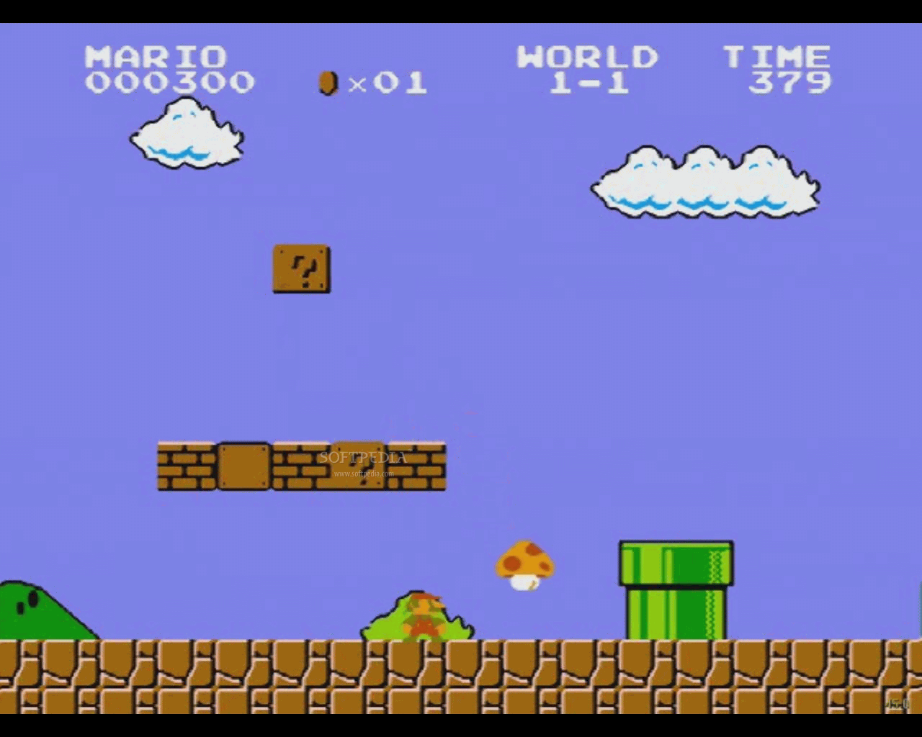

Slide 7
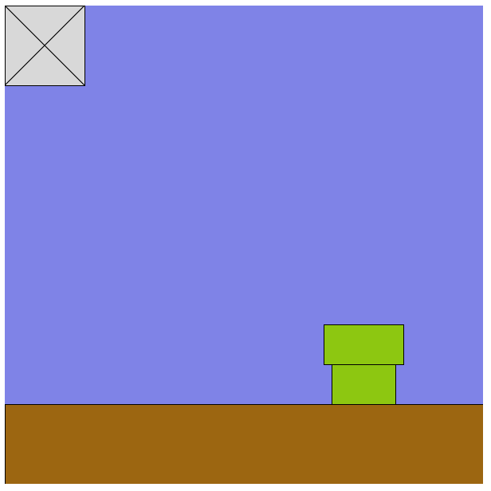
EXERCISE

Slide 8
Drawing a box
(0,0)
fill(216,216,216);
rect(0,0,100,100);
line(0,0,100,100);
line(100,0,0,100);
(100,100)
Notes:
Here some code that we can use to draw a face

Slide 9
Drawing a box
(0,0)
var size = 100;
fill(216,216,216);
rect(0,0,size,size);
line(0,0,size,size);
line(size,0,0,size);
(100,100)
Notes:
Change the size to make sure the box still draws

Slide 10
Drawing a box
(0,0)
var x = 0;
var y = 0;
var size = 100;
fill(216,216,216);
rect(x,y,size,size);
line(x,y,x+size,y+size);
line(x+size, y, x, y+size);
(100,100)
Notes:
After you have this done, change X and Y to move the box around

Slide 11
Some Terms
var bling;
var game;
function swagga () { do something... }
function swagga (bling, game) { bling + game }
function swagga (bling = 7, game = 2) {
bling + game = swagga;
console.log (swagga); // 7 + 2 = 9
}
swagga (7, 2); // 9
variable
function
parameter
value
statement
invoke

Slide 12
Drawing a box
function box() {
var x = 0;
var y = 0;
var size = 100;
fill(216,216,216);
rect(x,y,size,size);
line(x,y,x+size,y+size);
line(x+size,y,x,y+size);
}

Slide 13
Drawing a box
function box() {
var x = 0;
var y = 0;
var size = 100;
fill(216,216,216);
rect(x,y,size,size);
line(x,y,x+size,y+size);
line(x+size,y,x,y+size);
}
box();

Slide 14
Drawing a box
function box() {
var x = 0;
var y = 0;
var size = 100;
fill(216,216,216);
rect(x,y,size,size);
line(x,y,x+size,y+size);
line(x+size,y,x,y+size);
}
box();
box();
box();

Slide 15
Drawing a box
(0,0)
var box;
box = function() {
// ...
};
box();
(100,100)
Notes:
Our box should be back

Slide 16


Slide 17
Drawing a box
function() {
var x = 0;
var y = 0;
var size = 100;
fill(216,216,216);
rect(x,y,size,size);
line(x,y,x+size,y+size);
line(x+size,y,x,y+size);
}

Slide 18
Drawing a box
var box;
box = function() {
var x = 0;
var y = 0;
var size = 100;
fill(216,216,216);
rect(x,y,size,size);
line(x,y,x+size,y+size);
line(x+size,y,x,y+size);
};
Notes:
Dont forget the semicolon atthe end!
what happened to our box?

Slide 19
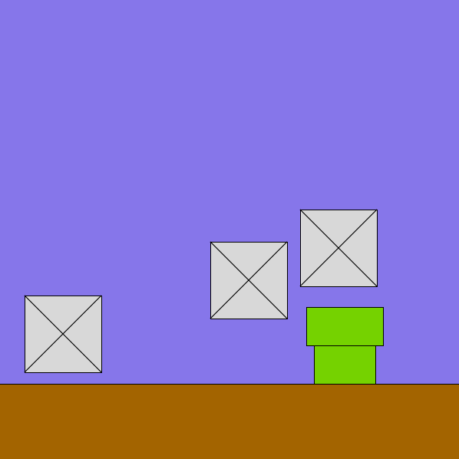
Drawing many boxes
var box;
box = function() {
var x = random(600);
var y = random(600);
// all that code stays the same
};
box();
box();
box();
Notes:
ok now we are get to let x and y change everytime we draw a box.

Slide 20
Drawing a box
(0,0)
var box;
box = function(x,y) {
var size = 100;
fill(216,216,216);
rect(x,y,size,size);
line(x,y,x+size,y+size);
line(x+size,y,x,y+size);
};
box(0,0);
(100,100)
Notes:
What happens if you DON’T call with arguments
change 0,0 to move the box around the screen

Slide 21
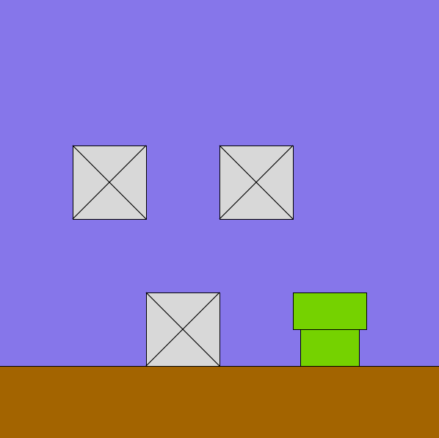
Drawing three boxes
var box;
box = function(x,y) {
// your function body
};
box(???);
box(???);
box(???);
Notes:
Draw a couple of boxes on the screen. Try to put them in places you might have them in a game.

Slide 22
CHALLENGE:
Change the box() function

Slide 23
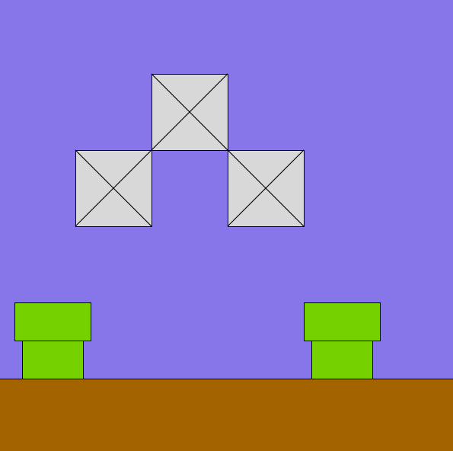
CHALLENGE:
Draw another pipe with functions!
Notes:
Here some code that we can use to draw a face

Slide 24
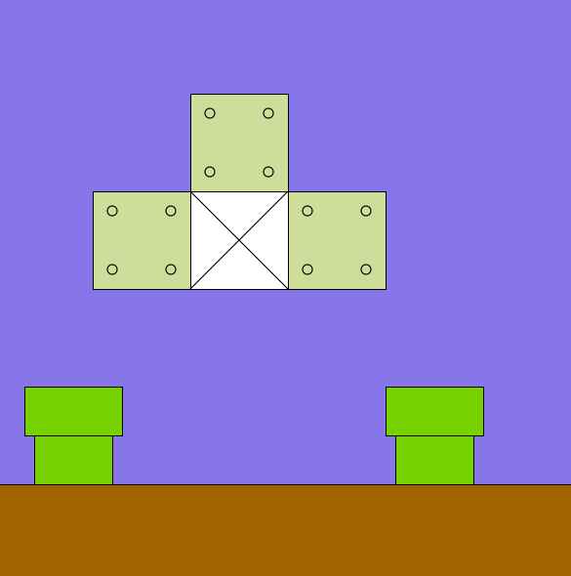
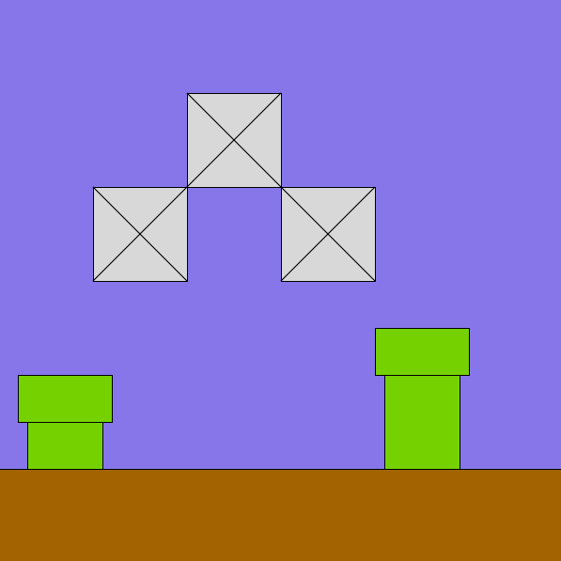
FUNCTIONS!

Slide 25


Slide 26
Programmers are lazy

Slide 27
Which would you rather type?
rect(100,100,200,200);
ellipse(150,150,25,25);
ellipse(250,150,25,25);
line(125,225,275,225);
rect(100,100,200,200);
ellipse(150,150,25,25);
ellipse(250,150,25,25);
line(125,225,275,225);
rect(100,100,200,200);
ellipse(150,150,25,25);
ellipse(250,150,25,25);
line(125,225,275,225);
box(50,50);
box(0,100);
pipe(100,100);

Slide 28
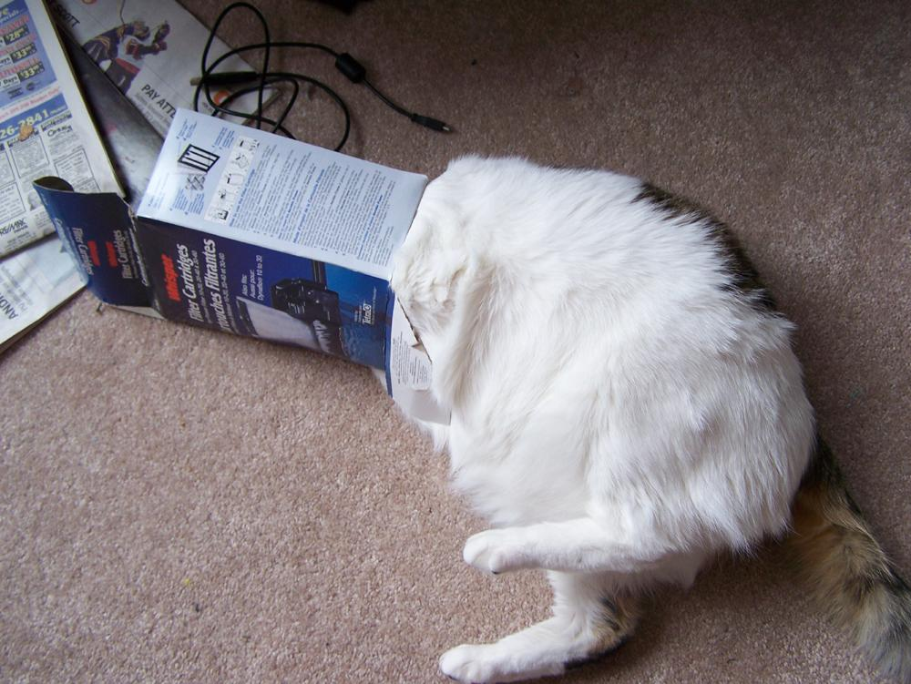
I don’t want to know

Slide 29
rect(10,100,200,100);

Slide 30
var rect;
rect = function(x,y,width,height) {
line(x,y,x+width,y);
line(x+width,y+height,x+width,y);
line(x+width,y,x+width,y+height);
line(x,y,x,y+height);
};

Slide 31
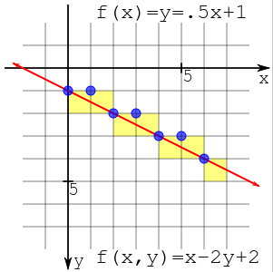
var rect;
rect = function(x,y,width,height) {
line(x,y,x+width,y);
line(x+width,y+height,x+width,y);
line(x+width,y,x+width,y+height);
line(x,y,x,y+height);
};

Slide 32
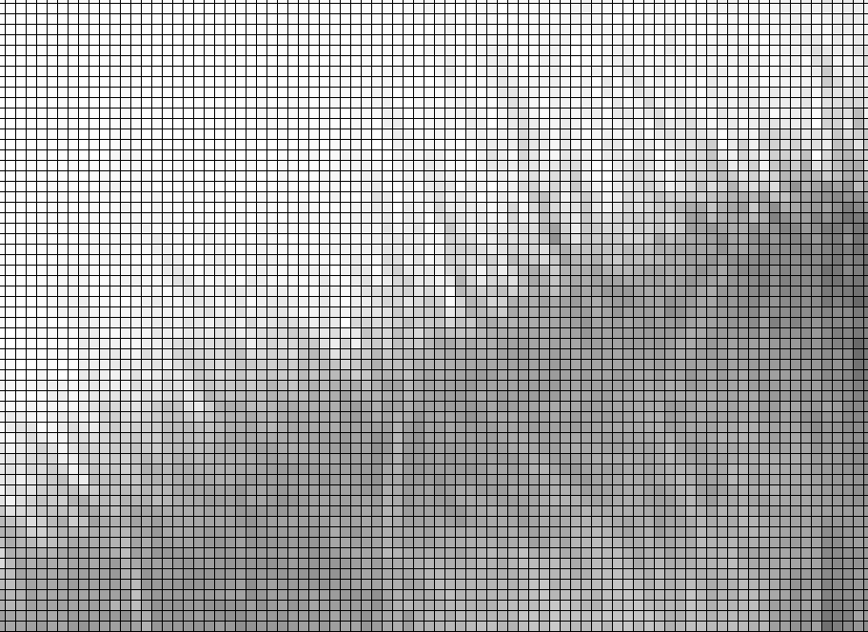
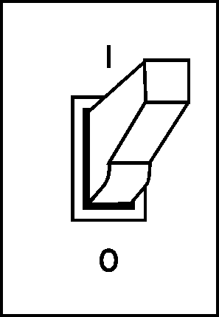
var rect;
rect = function(x,y,width,height) {
line(x,y,x+width,y);
line(x+width,y+height,x+width,y);
line(x+width,y,x+width,y+height);
line(x,y,x,y+height);
};

Slide 33
var rect;
rect = function(x,y,width,height) {
line(x,y,x+width,y);
line(x+width,y+height,x+width,y);
line(x+width,y,x+width,y+height);
line(x,y,x,y+height);
};
???

Slide 34
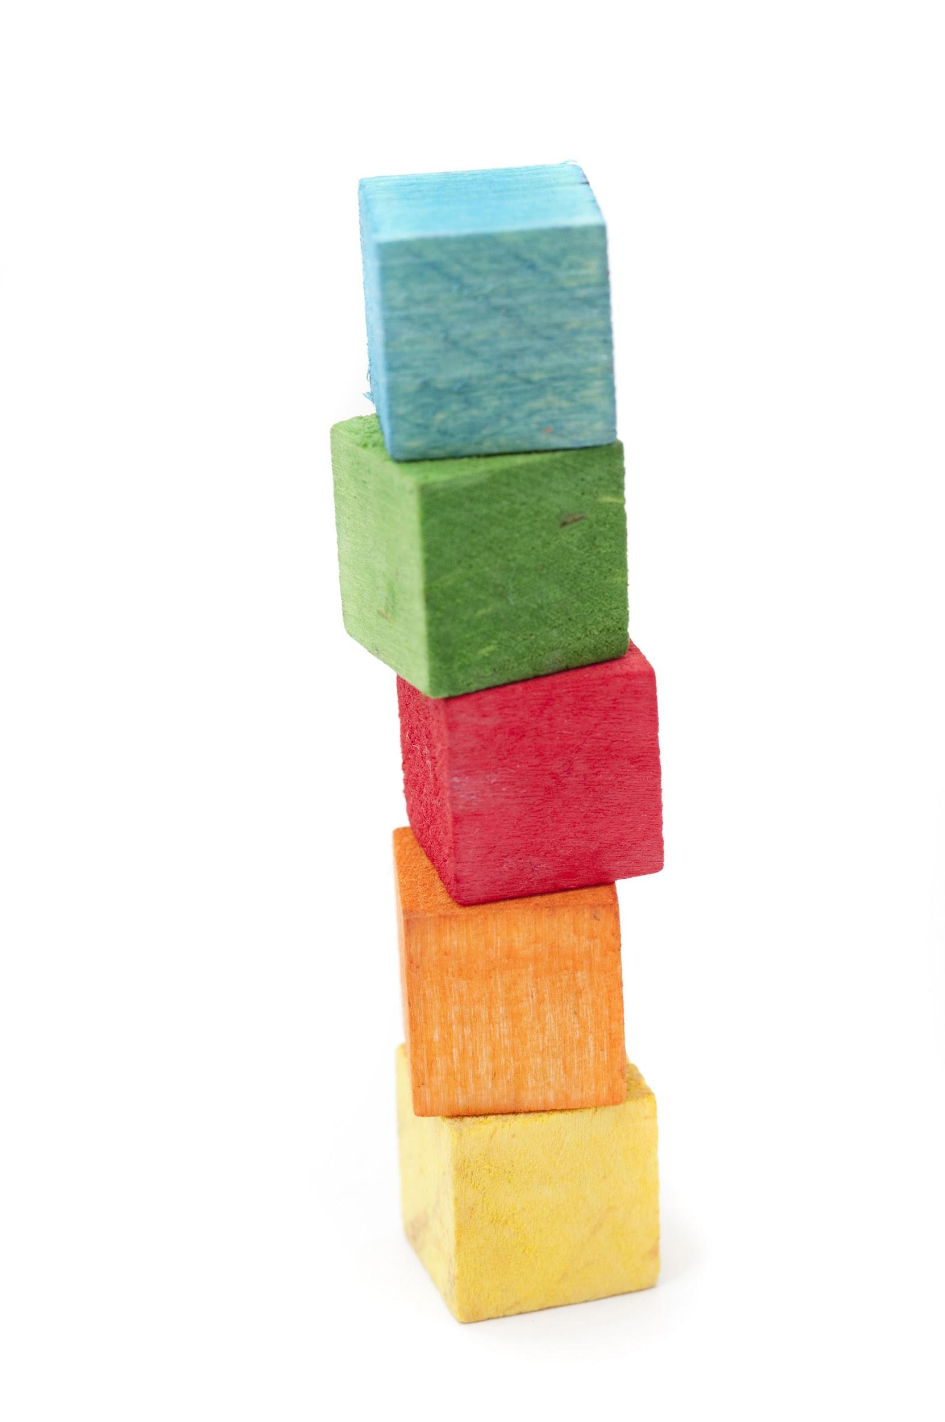
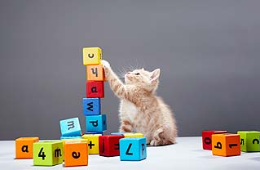
Functions are our building blocks

Slide 35
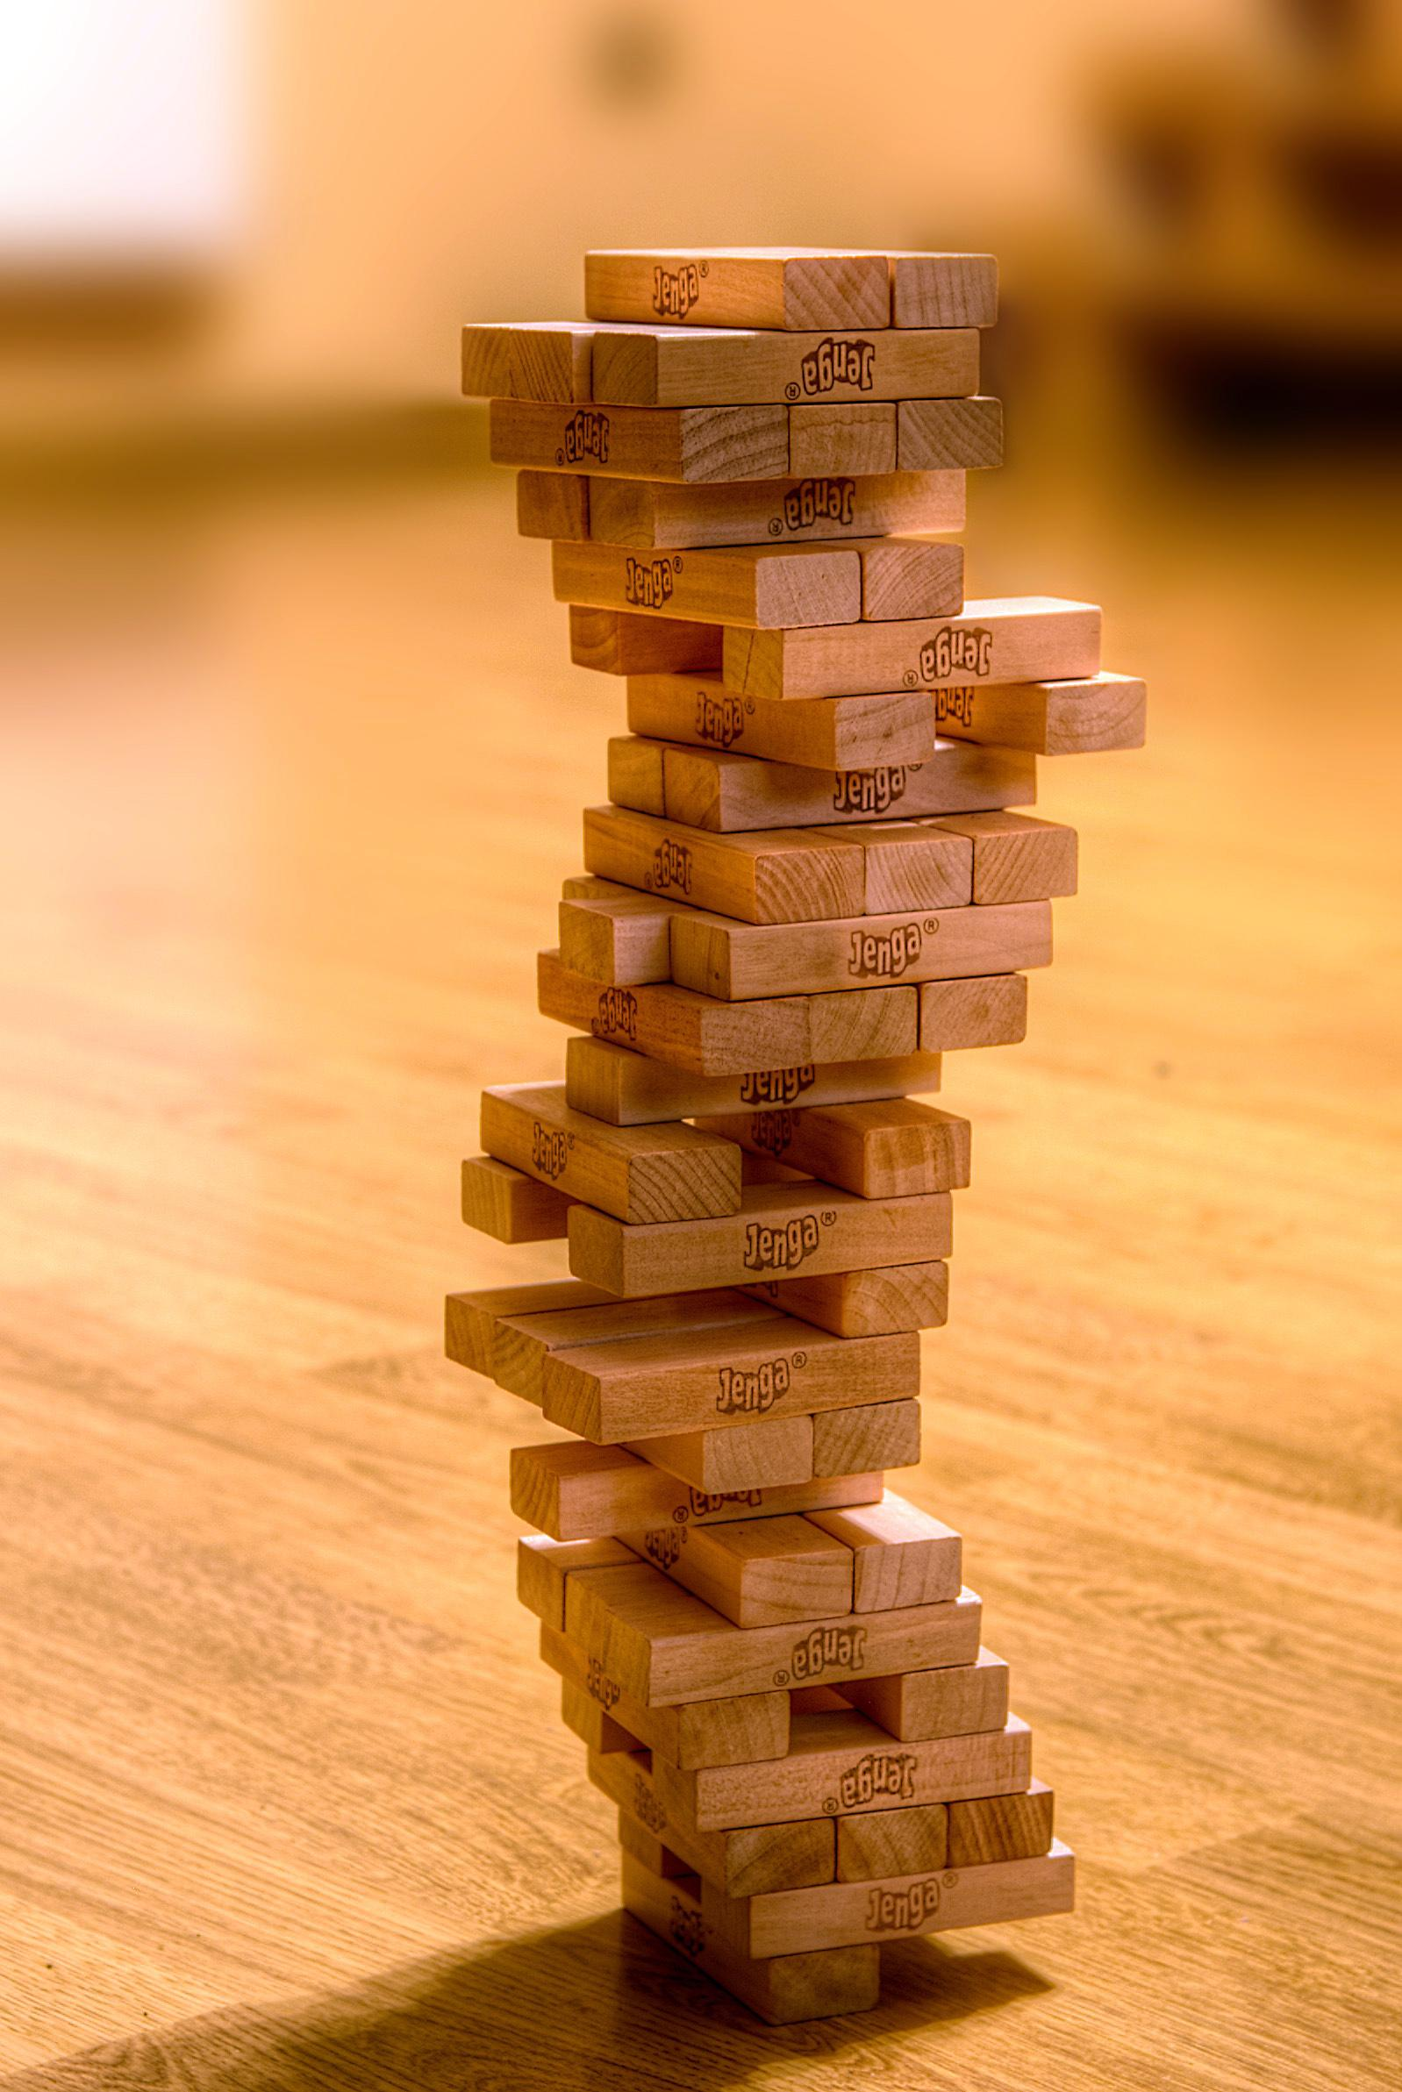
Comments are useful
// this is a comment
/*
this is also a comment
that goes over multiple lines
*/

Slide 36
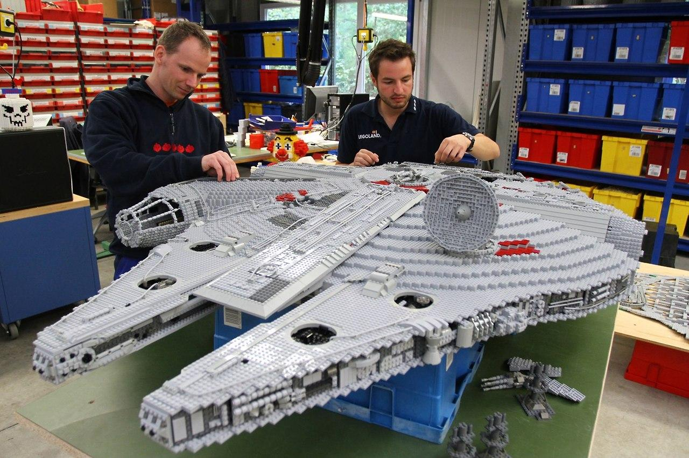

Slide 37
FUN FACT:
functions can return a value
var add;
add = function(x,y) {
return x+y;
};
var z = add(3,2);
Notes:
functions can also return values which we will talk about later. However, it isn’t really that complicated.
Can anyone guess what the value of Z is here?

Slide 38
Review - making Functions
var doStuff;
doStuff = function(x,y,z) {
rect(x,y);
ellipse(10+x,y+12,z,z);
};

Slide 39
Review - calling Functions
doStuff(1,2,3);
rect(10,100,25,25);
ellipse(1,1,100,100);

